Slide 1
Introduction
For this topic we will be focussing on the following:
Using PHP to Create a Complex Login Form
Creating a Database using MySQL
Creating a Table using MySQL
Populating a Table using MySQL
Using PHP to Create a Script that will allow us to View the content of our Table
Using PHP to Create a Complex Script to check the user’s Login details based on the data within the Database
We will now begin to focus on all of the above

Slide 2
Creating a Complex Login Form
For this part you may use a copy of your previous login form (simpleLoginForm.php) – make sure that you go through the following process:
Make a copy of simpleLoginForm.php
Rename your copy to complexLoginForm.php
Change line 2 of complexLoginForm.php so that it contains complexLoginCheck.php instead of simpleLoginCheck.php
Once you have completed the above process you should end up with the code and the form on the next slide

Slide 3
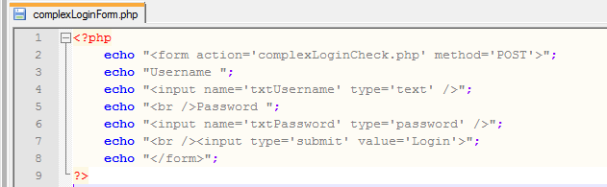
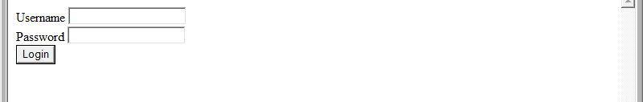
Creating a Complex Login Form
The code:
The Form:

Slide 4
Creating a Database using MySQL
The way that this version of the login will work will be that it checks a database to see if the User’s Login details are correct or not
The following process will happen when the User clicks on the Login button:
The Script will connect to the Database
The Script will check the SystemUser Table in the Database to see if the Username exists
If the Script finds the User then it will check the SystemUser Table to see if the Password matches the Username
If the Password matches then the User will have access to the System
If the Password does not match then a ‘Wrong Password’ message will appear
If the Script does not find the User then a ‘User not found’ message will appear

Slide 5
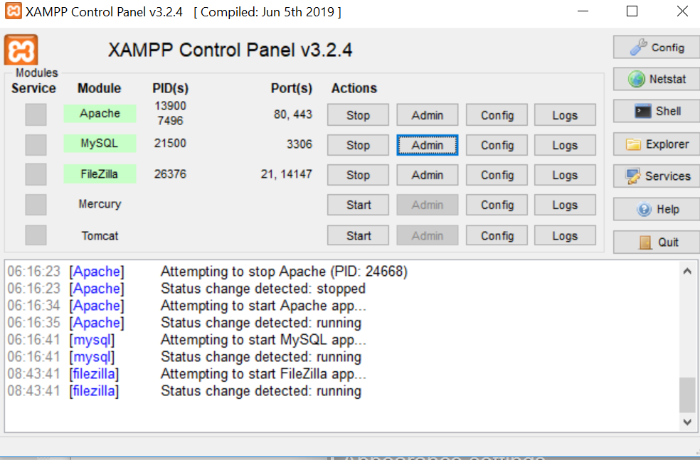
Creating a Database using MySQL
Before we can write the Script that accesses the Table within the Database we will need to create the Database on our Server
Click on the Admin for MySQL as shown in the image below

Slide 6
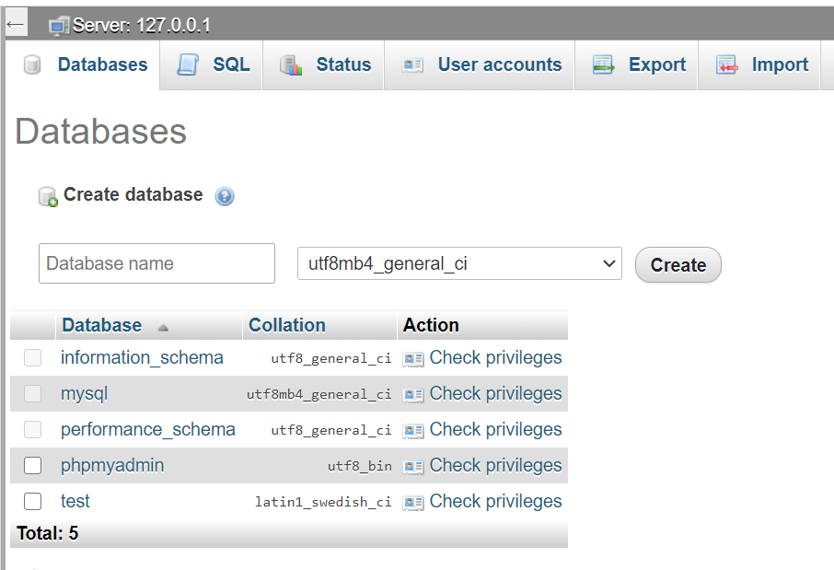
Create a Database
Click on create Database
Enter useful name for DB,
I call it socnet
It will prompt to create table,
check next slide for table creation.

Slide 7
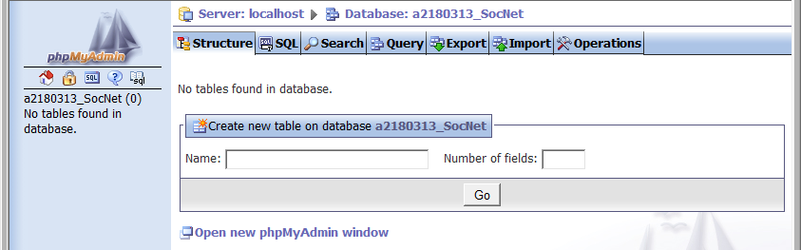
Creating a Table using MySQL –
You should now have the following screen
This is where you will have to name your Table and you will also need to say how many fields you are going to include in your Table

Slide 8
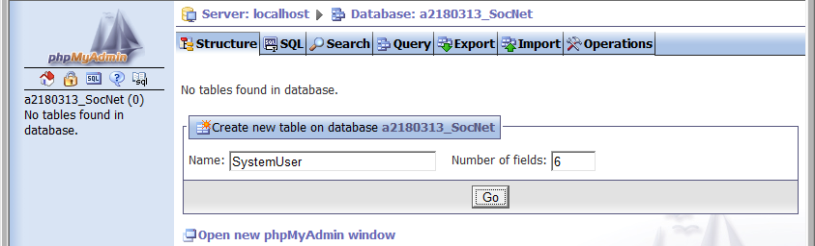
Creating a Table using MySQL
I have used the following values:
Once you have entered your values then click on Go to continue
The Table will be called SystemUser
There will be 6 Fields

Slide 9
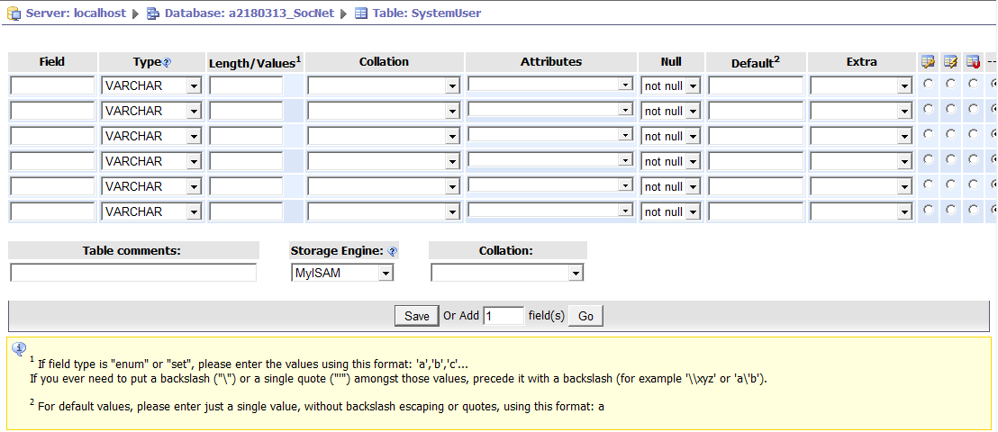
Creating a Table using MySQL
You should now have the following screen:
This screen will allow you to name all of your Fields as well as determine their Data Types and other settings

Slide 10
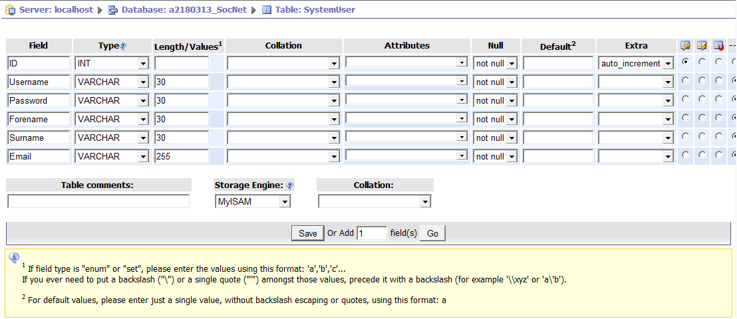
Creating a Table using MySQL
I have used the following values for my Table:
Make sure that you use similar values for your Table and click on Save once you have finished. For ID tick the A_I which is autoincrement. In some versions, it is a checkbox, next to null.

Slide 11
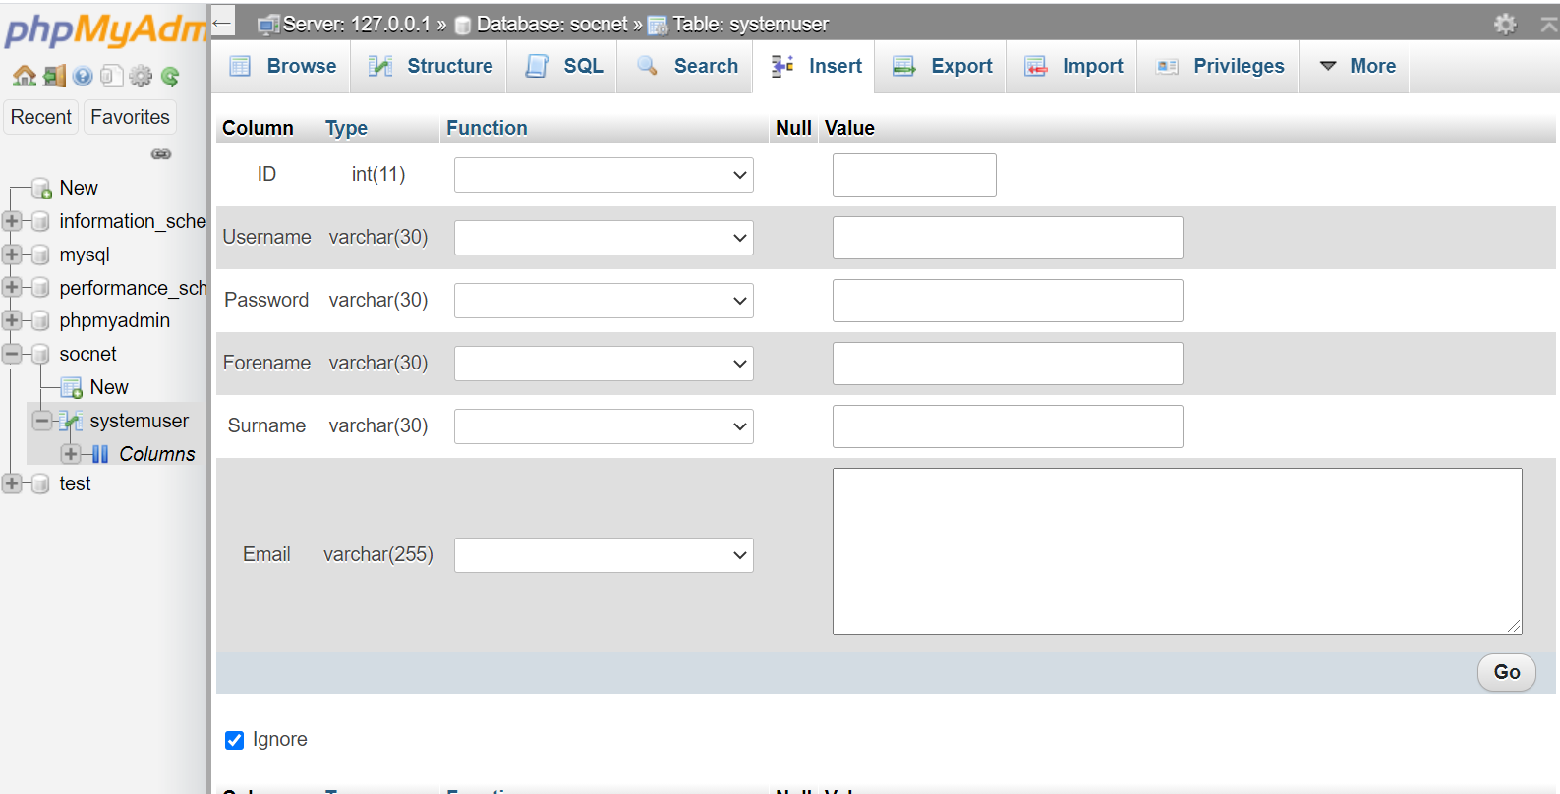
Populating a Table using MySQL
Now that we have our SystemUser Table within our Database we will need to add some Data
Add some data manually by clicking on Insert
We will create a registration page in coming weeks that will automatically put user records in this table.

Slide 12
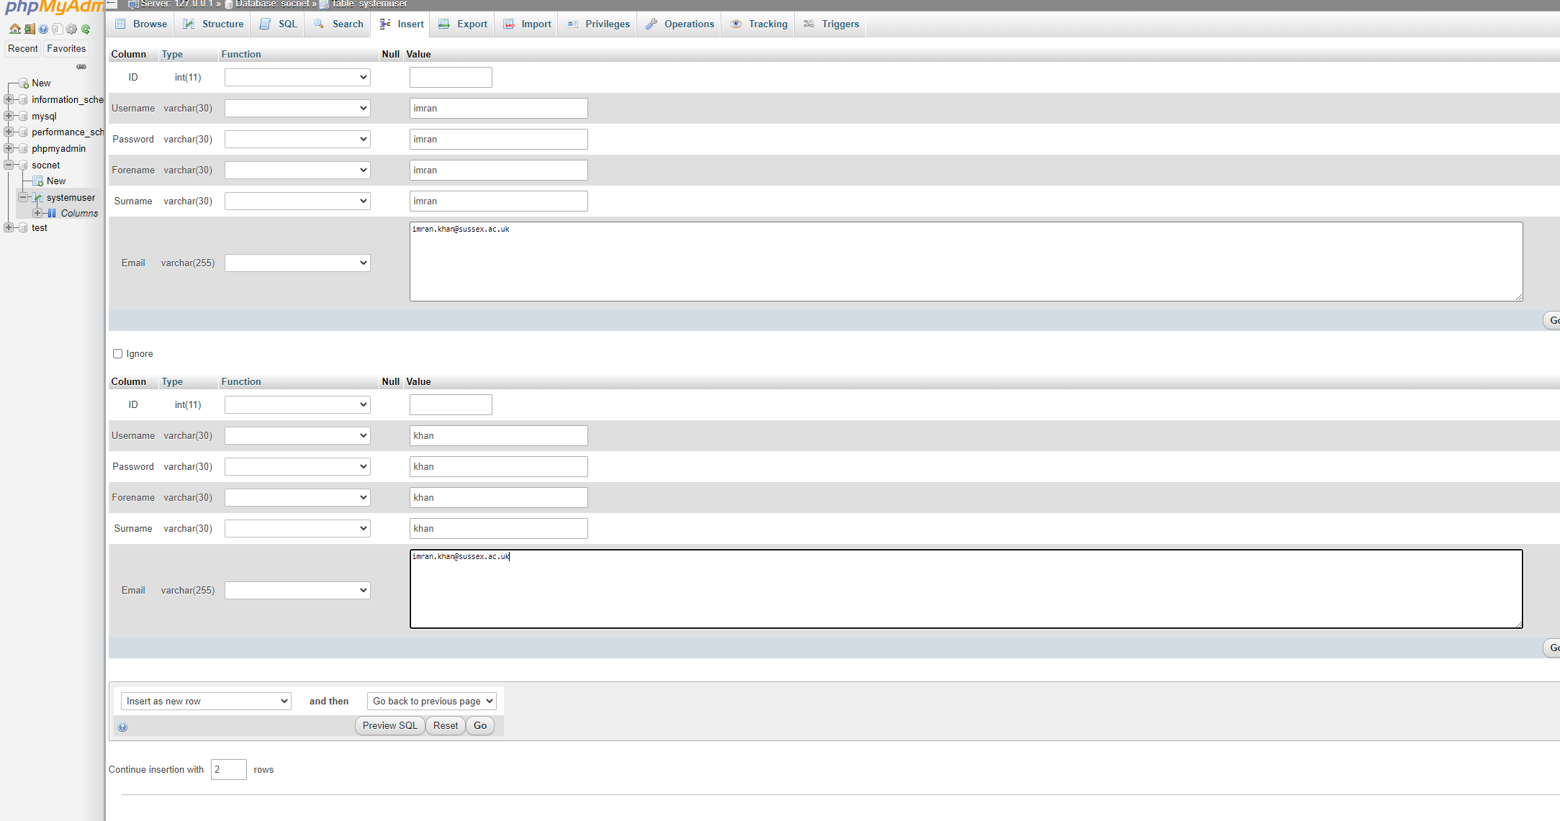
Populate few entries in your table
If you want more user records, specify here how many more records

Slide 13
Viewing a Table using a PHP Script
In order to get used to connecting to a Database, searching through Records in a Table and Displaying the Data within each one – I am going to show you how to complete the following things using PHP:
Connecting to your Server
Selecting your Database
Finding Records (Users) within your SystemUser Table
Displaying all of your Records (Users) in a HTML Table within a Browser window

Slide 14
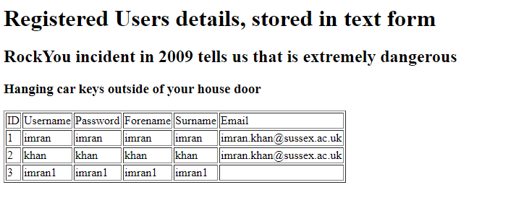
Viewing a Table using a PHP Script
Once your PHP Script is working and running you should get something similar to the following screen within your Browser:

Slide 15
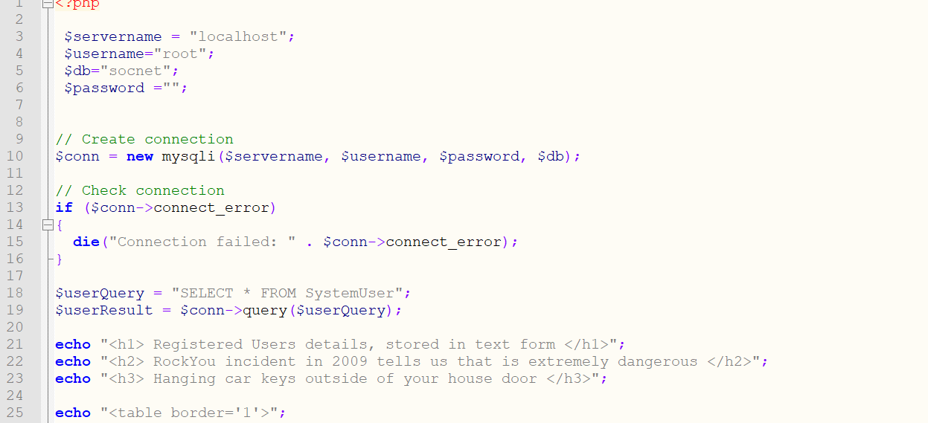
Viewing a Table using a PHP Script
Here is the first part of the PHP Script that I have saved as viewUsers.php.

Slide 16
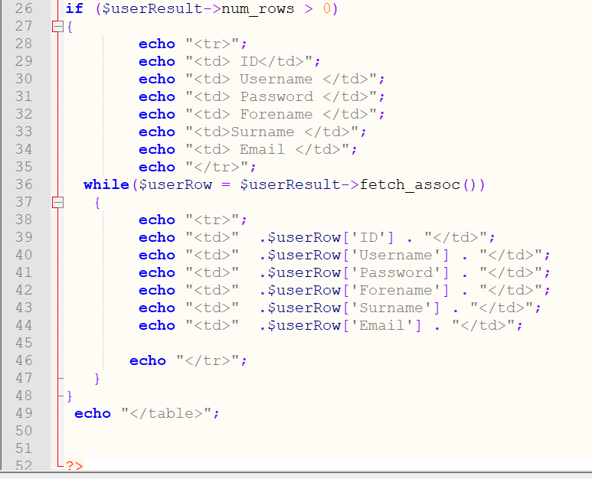
Viewing a Table using a PHP Script
Remaining part of viewUsers.php:
View your viewUsers.php in browser, you will get the output all users details which is stored in text form

Slide 17
Creating a Complex Login Script
At this point we have the following things:
A Database on our Server
A Table called SystemUser within our Database
User Records within our SystemUser Table
A working PHP Script that shows all of the Users within our System
The next step is to create a PHP Script that will check the details, that could be entered into the Form, that was created using a PHP Script (complexLoginForm.php) right at the start of this Presentation

Slide 18
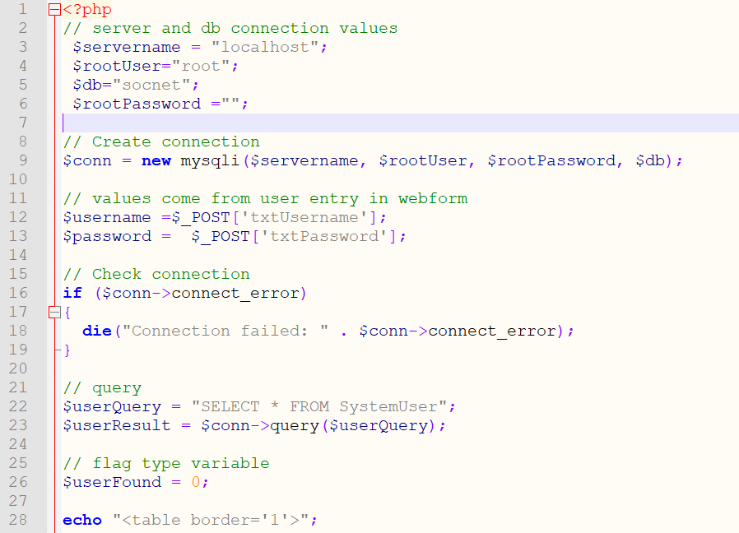
Creating a Complex Login Script
Here is the first part of the complexLoginCheck.php Script, that will check the User’s Login details to see if the User exists within the SystemUser Table and if they do then it will check to see if the Password is correct:

Slide 19
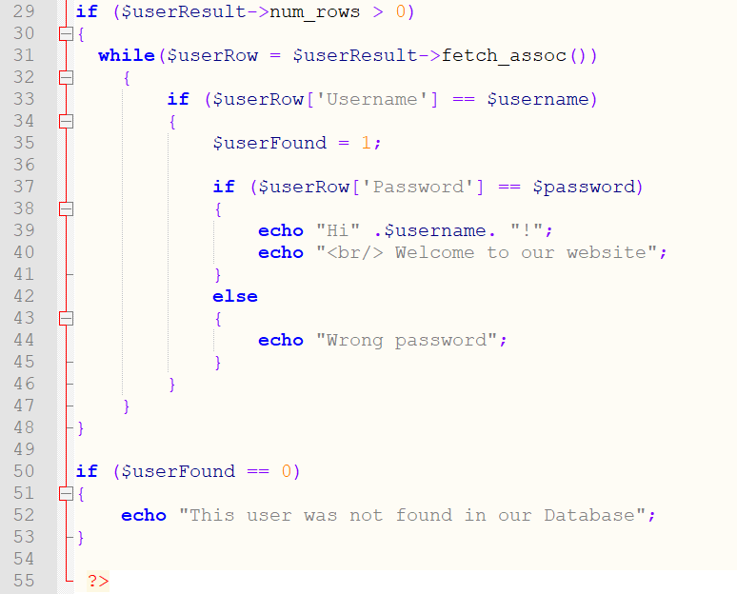
Creating a Complex Login Script
Remaining part of complexLoginCheck.php

Slide 20
Creating a Complex Login Script
Testing the Script – Make sure that you test the Script for all of your Users:
Check to see if it finds all Users – Test one User at a time
Check to see if the Passwords work for all Users – Test one User at a time
Check to see if it displays the Wrong Password message for all Users by using an incorrect Password for each User – Test one User at a time

Slide 21
Summary
Today we looked at all of the following:
Using PHP to Create a Complex Login Form
Creating a Database using MySQL
Creating a Table using MySQL
Populating a Table using MySQL
Using PHP to Create a Script that will allow us to View the content of our Table
Using PHP to Create a Complex Script to check the user’s Login details based on the data within the Database

